Slide 1

ARINC 429 Midterm Presentation
Team Caterpillar
10/15
This presentation outlines a the concept security gateway design of ARINC 429 data bus.

Slide 2



Our team
Team Caterpillar
Joshua
Nate
Brandon

Slide 3
Content overview ARINC 429
Team Caterpillar
1
2
3
ARINC Use Case
ARINC Technical Overview
SYSML
4
5
6
Threat Model
Demo
Questions

Slide 4

What is ARINC 429?
Team Caterpillar
The ARINC 429 is a data bus used in commercial, private, and military aircrafts to transport avionic data throughout the plane.
This includes all of the flight data like the radar, relative pitch and yah, airspeed, data to the black box and much more information.

Slide 5

How Does ARINC work?
1 transmitter sends data to up to 20 receivers through a single twisted wire pair in which it is unidirectional.
The LRUs transmits 32-bit words, in which 24 of those bits contain data and 8 bits describe the data.
There are no addresses for the LRUs but equipment IDs
Transmission rates can either be 12.5 kHz or 100 kHz with a deviation of 1 and only one of these rates can be used at a time.
Team Caterpillar

Slide 6

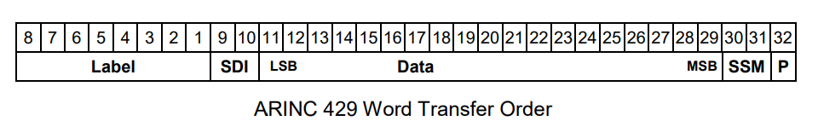
How Does ARINC work Continued
P (parity): P bit ensures there are an odd number of 1’s. If there are an even number of ones that means the word was damaged in transit.
SSM: Provides context for the data (cardinal direction, positive or negative, ect)
Data: The data that the receiving LRU interprets
SDI: Informs the LRU of all receivers
Label: Informs LRU on what type of data (velocity, radar, intercom, ect)

Slide 7
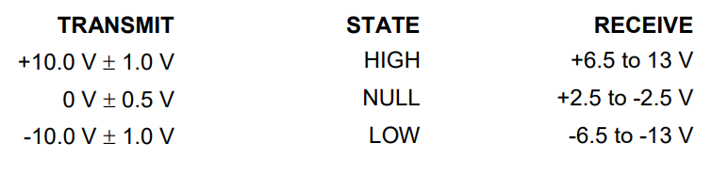
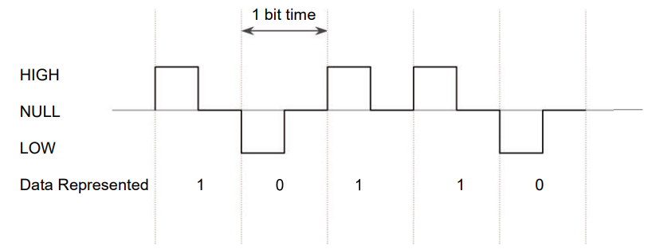
Team Caterpillars
The data is transmitted in a Return-to-Zero (RZ) format which is a tri state modulation which can has HIGH, NULL, or LOW
When determining what the data is, the voltages are measured at the output terminal at the source and at the receiver.
The data is measured in bit cycles where the first half is where the voltage is measured and the second half is where it goes back to NULL.
Since the cycle returns to zero, there is no need for an external clock

Slide 8
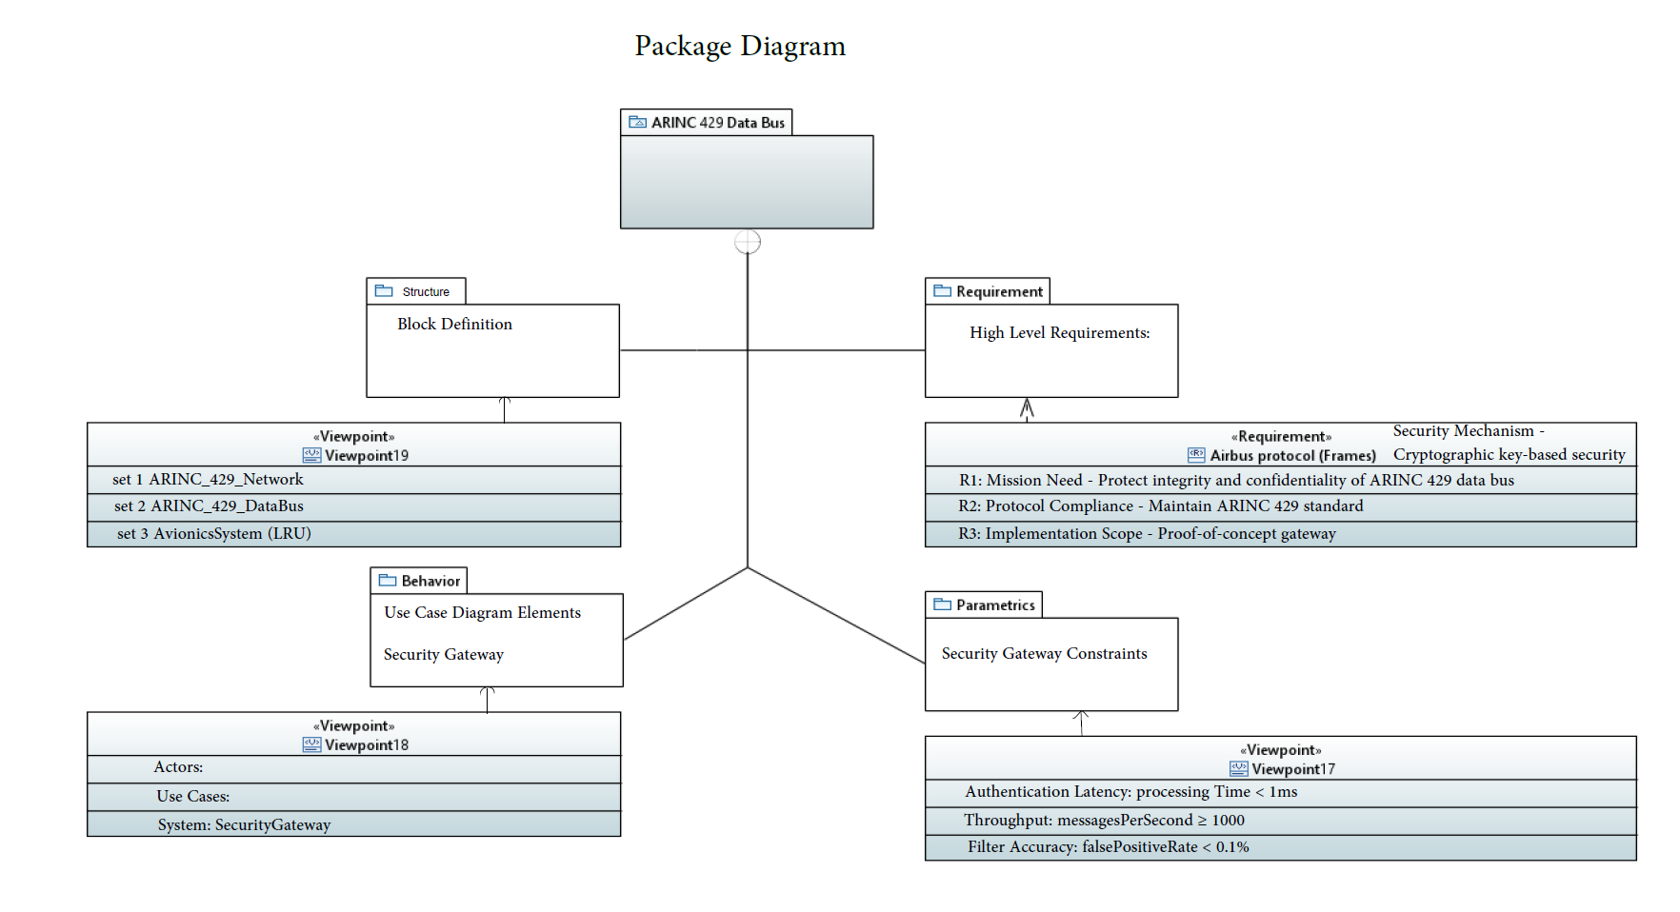
SYSML model (Package)
Team Caterpillar
ARINC 429 data bus is critical domain for aircraft.
Handles essential data from flight information to radar data to black box recordings.
Mission is to protect the integrity and confidentiality of data transmitted across this vital bus.

Slide 9
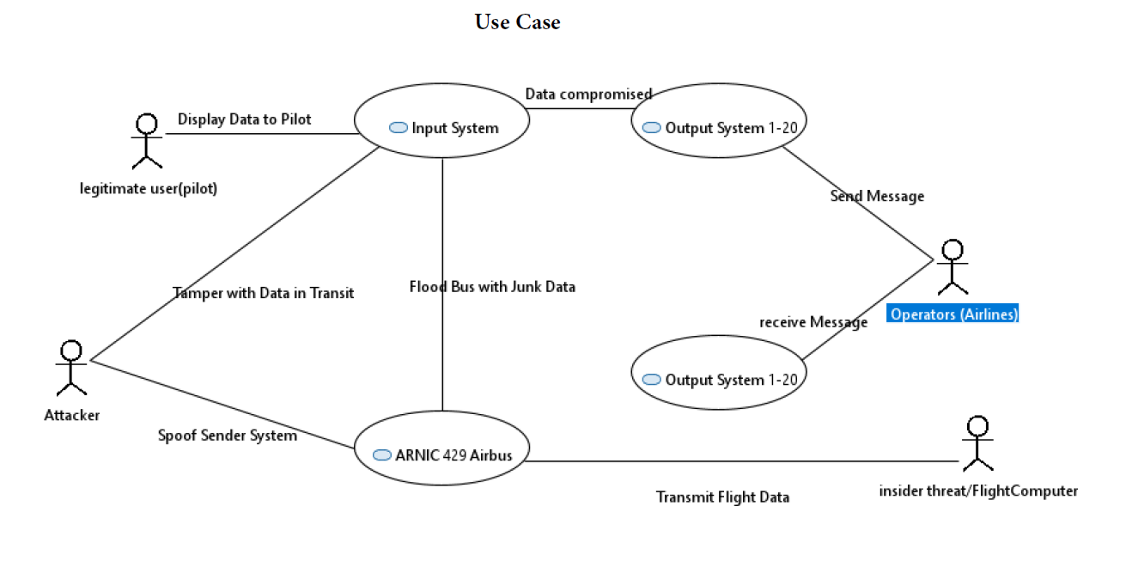
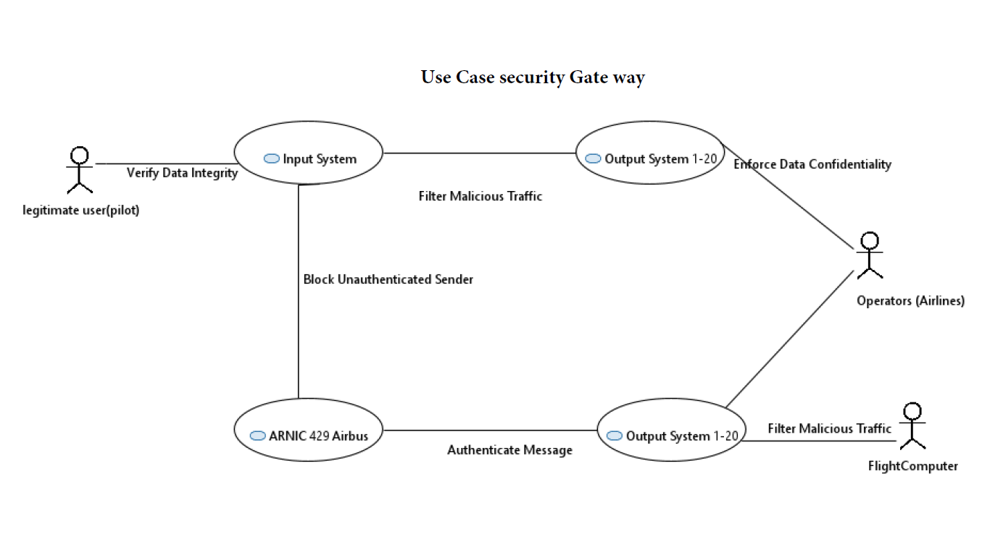
SYSML model (Use case)
Team Caterpillar
Normal Operations:
Transmit flight data
Display data to the Pilot
Identified Attack: spoof, Flood Bus…
Security Gateway Mitigations:
Authenticate to verify sender identity.
Verify data integrity to check for tampering.
Filter Malicious Traffic to stop bus flooding.
Enforce Data confidentiality.

Slide 10
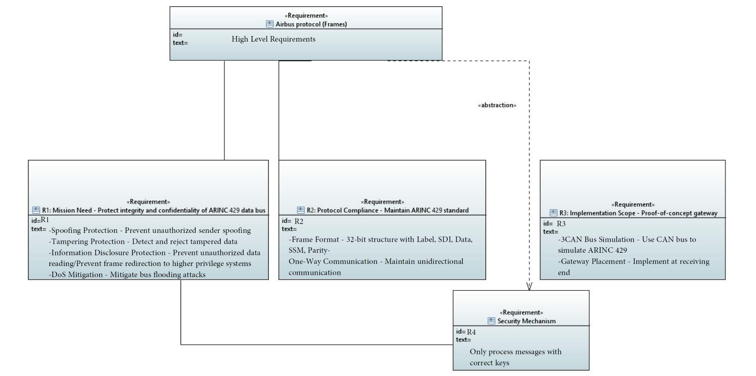
SYSML model (Requirement)
Team Caterpillar

Slide 11
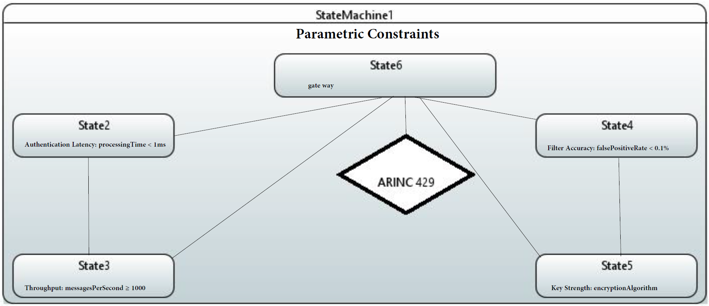
SYSML (Parametric)
Team Caterpillar

Slide 12
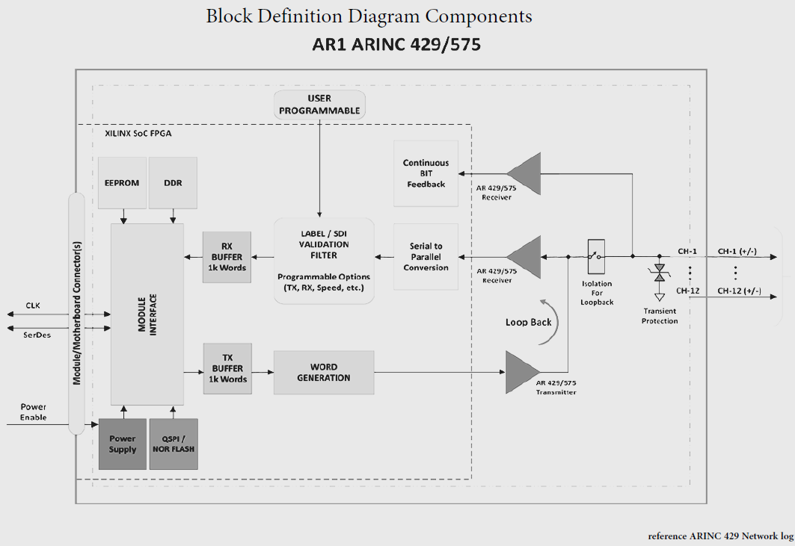
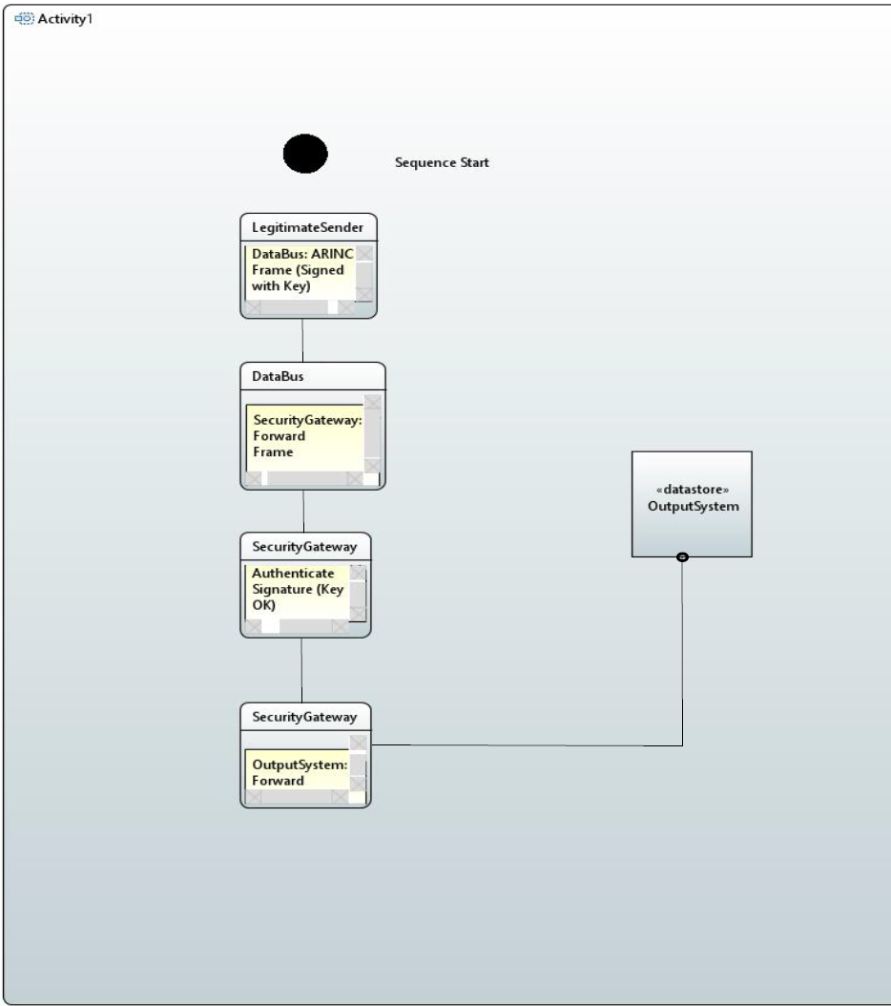
Sequence/Block DDC
Team Caterpillar
Normal Secured Operation:
Legitimate sender transmits a frame signed with a cryptographic key.
The Security Gateway authenticates the signature successfully.
Validated data is forwarded to the output system for processing.
Attack Mitigation Scenario:
An attacker transmits a frame with an invalid or missing key.
The Security Gateway fails the authentication check.
The malicious frame is silently discarded, protecting the output system.

Slide 13
Threat Modeling
Team Caterpillar
 | Altered Frames (Tampering) | Replay (Spoofing)
Damage | (3) Can affect all receiving nodes on the same bus | (3) Can affect all receiving nodes on the same bus
Reproducibility | Frame specifications varies by manufacturer | (3) does not require knowledge of data specifications, attack stays the same if the same LRU is compromised each time
Exploitability | Requires physical access, custom malware, and knowledge of how receivers interpret data | (2) Requires physical access and custom malware
Affected users | (3) Potential for all passengers to be affected | (3) Potential for all passengers to be affected
Discoverability | (2) Knowledge of theoretical attack is easily discoverable due to public protocol information, however label and data specifications are not public | (2) Knowledge of theoretical attack is easily discoverable due to public protocol information, however label and data specifications are not public
Total | 10 (Medium) | 13 (High)

Slide 14
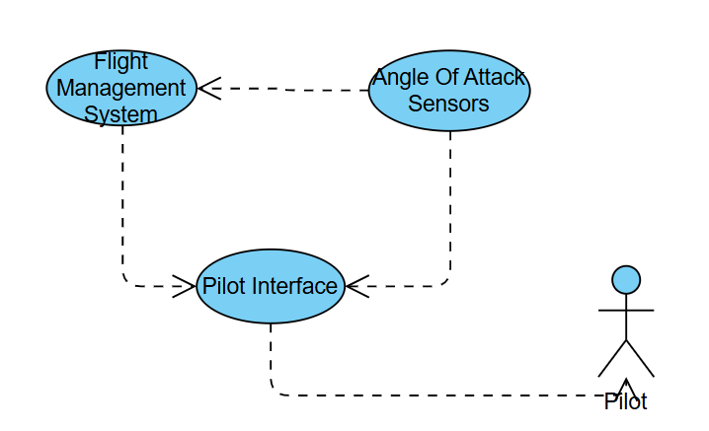
Demo
Team Caterpillar
Aviation data
Auto pilot data
Aviation data
Flight data

Slide 15
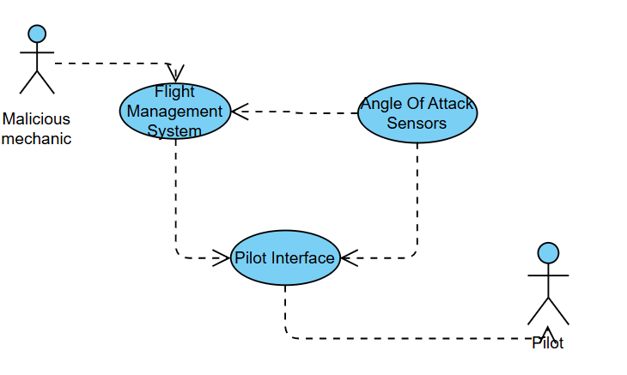
Demo Cont.
Team Caterpillar
Malware
Aviation data
Aviation data
Malicious Replayed Aviation data Flood
Malicious Replayed Aviation data Flood

Slide 16

Demo Cont.
Team Caterpillar

Slide 17

References and Questions?
[1] https://github.com/JoshuaMFrench/CYSE465-Caterpillars-Group
[2] B. Waldmann. ARINC 429 Tutorial, v2.2. (2019). Accessed: September 12th, 2025. [Online]. Available: https://www.aim-online.com/wp-content/uploads/2019/07/aim-tutorial-oview429-190712-u.pdf
[3] https://www.omg.org/sysml/INCOSE-OMGSysML-Tutorial-Final
Team Caterpillar

Slide 18
Individual Contribution
Team Caterpillar
Josh
Nate
Brandon
Team Effort
Initial case study for the proposal with team. .
Python simulation of communication protocol
Python simulation of replay attack
Recorded Demo
Prepare and structure the powerpoint with team.
Initial case study for the proposal with team.
System Architecture (Sysml model).
Initial Python simulation for testing communication with terminal.
Prepare and structure the powerpoint with team.
Initial case study for the proposal with team
Simulating communication with terminals
Pushed updates to the Repository
Prepare and structure the powerpoint with team
It was “All hand on deck” approach for the project until the Midterm.

Slide 19
Thank you

